Slide 1


Virtual Reality And Hand Rehabilitation
By: Nahian Ahmed

Slide 2

Problems with Hand Rehabilitation
The human hand is the part of the body most frequently injured in work related accidents
Accounts for a third of all work-related accidents
Involves surgery and long periods of rehabilitation
May cause an individual to take long period of leave from work or may lose job permanently
Physical hand therapy take about an hour and a half on average and frequent visits depending on the accident

Slide 3
Prevalence of VR in Healthcare
Stroke Rehabilitation
is performed to control the symptom and aftermath of a stroke.
Pain management
becomes the coping mechanism of the patient’s brain who is suffering from painful sensations and helps them to overcome them
Cancer Rehabilitation
chemotherapy virtual reality is recommended to increase the prospects of disease-free survival and eradicate the tumor mass.
Spinal Cord
the impact of VR on people′s multisensory perception, movements, attitudes, and even modulations of socio-cognitive aspects of their behavior have influence in rehabilitation
Vision
Artificial Intelligence driven vision therapy suitable for amblyopia, accomodation, hand-eye coordination, and more
Anxiety and Stress Level
VR therapy encourages nervous system regulation and calms the mind with fun-filled distractions the over-thinking brain needs.

Slide 4
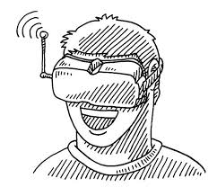
VR in Hand therapy
Patients wearing a VR helmet look down and see two virtual arms and two virtual hands. They are able to use their virtual body/hand to interact with objects in the virtual world. This can be used for amputees, or even for non-amputees
VR therapies in hand rehabilitation include Mirror Therapy, Bio Feedback, and Observation of Movement. The hand that requires therapy is controlled by Electromyography (EMG) signals. The patient gets involved in task oriented repetitive challenges. This interactive illusion provides the best possible stimulation of neuroplasticity to support rehabilitation of the paretic hand.

Slide 5
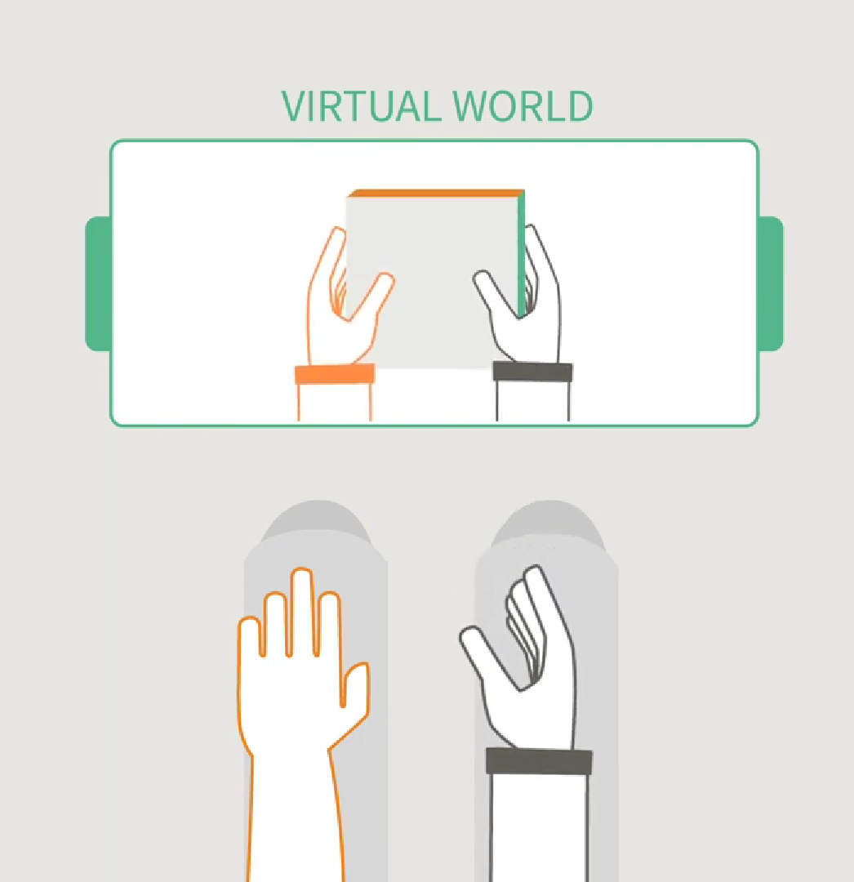
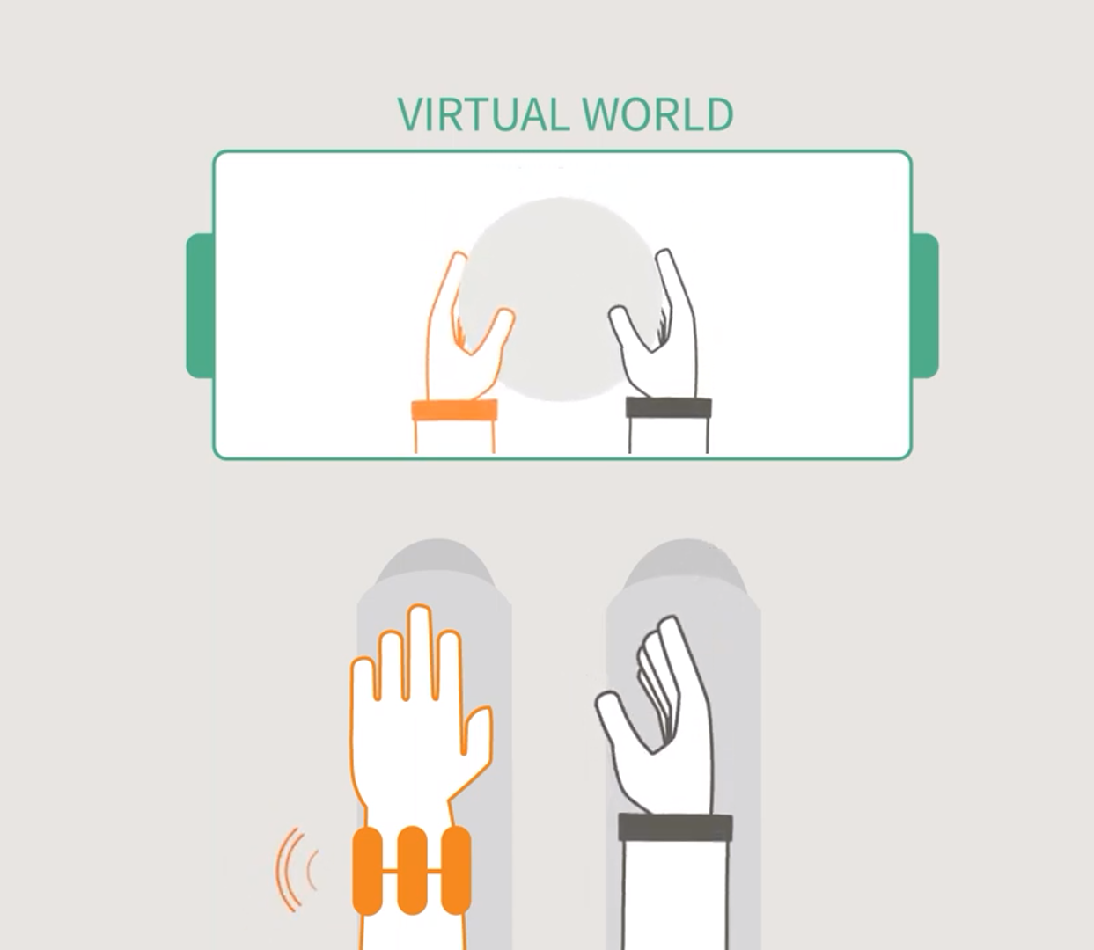
Demo
Figure: Mirror Therapy
Figure: Bio Feedback

Slide 6
Conventional Vs Virtual Reality Therapy
Conventional Physical Therapy | Virtual Reality Rehabilitation
Limits mobility | Involves increased interactivity like seeing, hearing, communicating etc
Repetitive exercises get discouraging | Repetitive exercises promotes encouragement
Increased focus on pain since the mind is not distracted | Decreased focus on pain as the mind take an account of all the occurrences in a VR environment
A typical process which does not incorporate anything new | A unique process which allows patients to look forward to a redefined therapy
Fails to provides any objective data over time | Records, maintains and tracks data as the therapy progresses

Slide 7

Future of Hand Rehabilitation
VR may increase patients’ compliance with hand therapy homework exercises, by making the hand therapy exercises less painful and more fun, during home use.
VR can be used to help monitor whether, when, and how well patients are doing their hand therapy exercises, and to quantify whether adherence to treatment increases long term functionality.
Consumer ready immersive virtual reality and augmented reality technologies can likely be harnessed by physical and occupational therapists to help improve the medical and psychological outcome of patients undergoing hand therapy, improve patient satisfaction, and thus reduce healthcare costs.

Slide 8
Sources
Pereira, Margarida F, et al. “Application of AR and VR in Hand Rehabilitation: A Systematic Review.” Journal of Biomedical Informatics, U.S. National Library of Medicine, pubmed.ncbi.nlm.nih.gov/33011296/.
“Using VR in Rehabilitation - Benefits and Use Cases.” COGNIHAB, www.cognihab.com/blog/using-vr-in-rehabilitation-benefit/#:~:text=Virtual%20Reality%20in%20Rehabilitation&text=This%20is%20primarily%20because%20in,it%20does%20in%20physical%20therapy.
“VR Rehabilitation vs Conventional Physical Therapy for Stroke Rehabilitation.” COGNIHAB, www.cognihab.com/blog/virtual-reality-rehabilitation-vs-physical-therapy/.
Hoffman, Hunter G, et al. “Virtual Reality Hand Therapy: A New Tool for Nonopioid Analgesia for Acute Procedural Pain, Hand Rehabilitation, and VR Embodiment Therapy for Phantom Limb Pain.” Journal of Hand Therapy : Official Journal of the American Society of Hand Therapists, U.S. National Library of Medicine, 2020, www.ncbi.nlm.nih.gov/pmc/articles/PMC7719341/#:~:text=Patients%20wearing%20a%20VR%20helmet,or%20even%20for%20non%2Damputees.
“Rewellio (Fka Psii.Rehab) – Virtual Reality (VR) Based Hand Rehabilitation for Stroke Patients.” YouTube, YouTube, 4 Aug. 2017, https://www.youtube.com/watch?v=EgGqS2zkpv8.

Slide 9

Questions?

